Slide 1
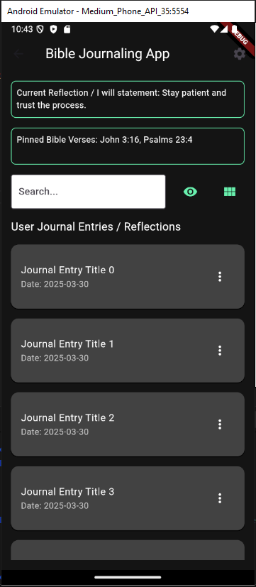
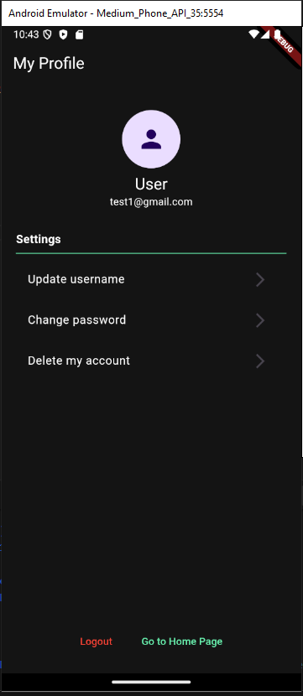
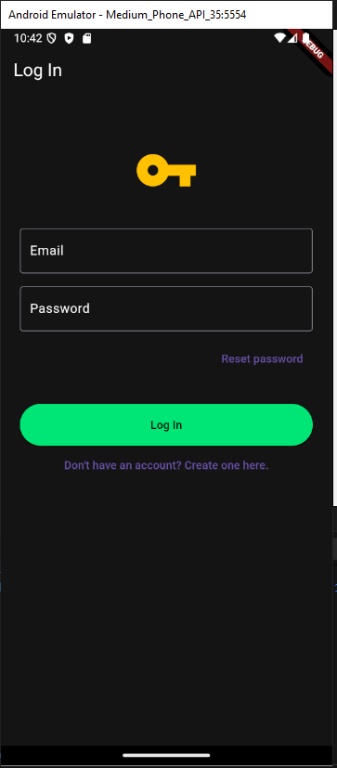











Bible Journaling App
Easten A. Elefson – Software Design & Development Major
Project Justification
The Bible journaling app merges traditional journaling practices with a modern digital organization system. It provides users with a platform to maintain the timeless practice of journaling while offering the benefits of digital accessibility and structure. By digitizing the journaling process, the app empowers users to document their thoughts, deepen their connection with scripture, and reflect on their faith in a structured and meaningful way.
Application Design
Application Features
Digital Journaling and Reflections
Pinned Bible Verses
Search by Keywords, Topics, or Tags
Journal / Reflection Toggle
OpenAI Integration
Enhanced Privacy with Encryption
Bible Lookup Integration
Journal Organizational Features
Profile Management
Technologies Used
Phone: 602-529-6847
Email: gbadge13@gmail.com

